Slide 1
Virtual Factory
ARMES

Slide 2
Demo high level architecture
CWYF
Chat with your factory prompt and responses
Dashboard
Ignite
ArMES
Machine data
Kafka / API
Reports
ERP
Simulation Events

Slide 3
Demo high level architecture
CWYF
Chat with your factory prompt and responses
Dashboard
Ignite
ArMES
Machine data
Kafka / API
Reports
ERP
Simulation Events

Slide 4
Demo high level architecture
Machine Characteristics
Cycle Time
Production rate
Sensor Data Limits
Machine
Generic State data
Status (Running, Idle, Offline, Maintenance)
Raw-In, Prod_Out
Error/Fault
Energy Usage
Machine Specific data
Speed,
Temperature,
Pressure,
Vibration
…

Slide 5
Virtual Factory
# 2
Semi Product
Buffer
Raw Material Storage
Machine # 1
Operator Station
# 4
Product
Assembly
Buffer
# 5
Quality Control
Buffer
# 6
Packaging
Warehouse
# 3
Semi Product
Buffer
Waste
Waste/Scrap
INPUT
OUTPUT
OEE
First Pass Yield
MTBF
Mean Time To Repair
Capacity Utilization
Throughput Rate
Bottleneck Analysis
Cost Per Unit, Manufacturing Cost Variance, Cost Driver Analysis, Resource Consumption Efficiency
Product List
Labor List
Bill of materials
Planned production
Setup/changeover schedule
Material Inventory
Warehouse Stock
Cycle Capacity
Status (Running, Idle, Offline, Maintenance …)
Speed, Temperature, Pressure, Vibration
Error/Fault
Energy Usage
Total/Defective production
Defect category
Buffer utilization
Production Lab. Test Results
Material waiting time
Ambient temperature
Humidity
Machine Operator

Slide 6
Data
Pattern
Data Generator
Data Queue

Slide 7
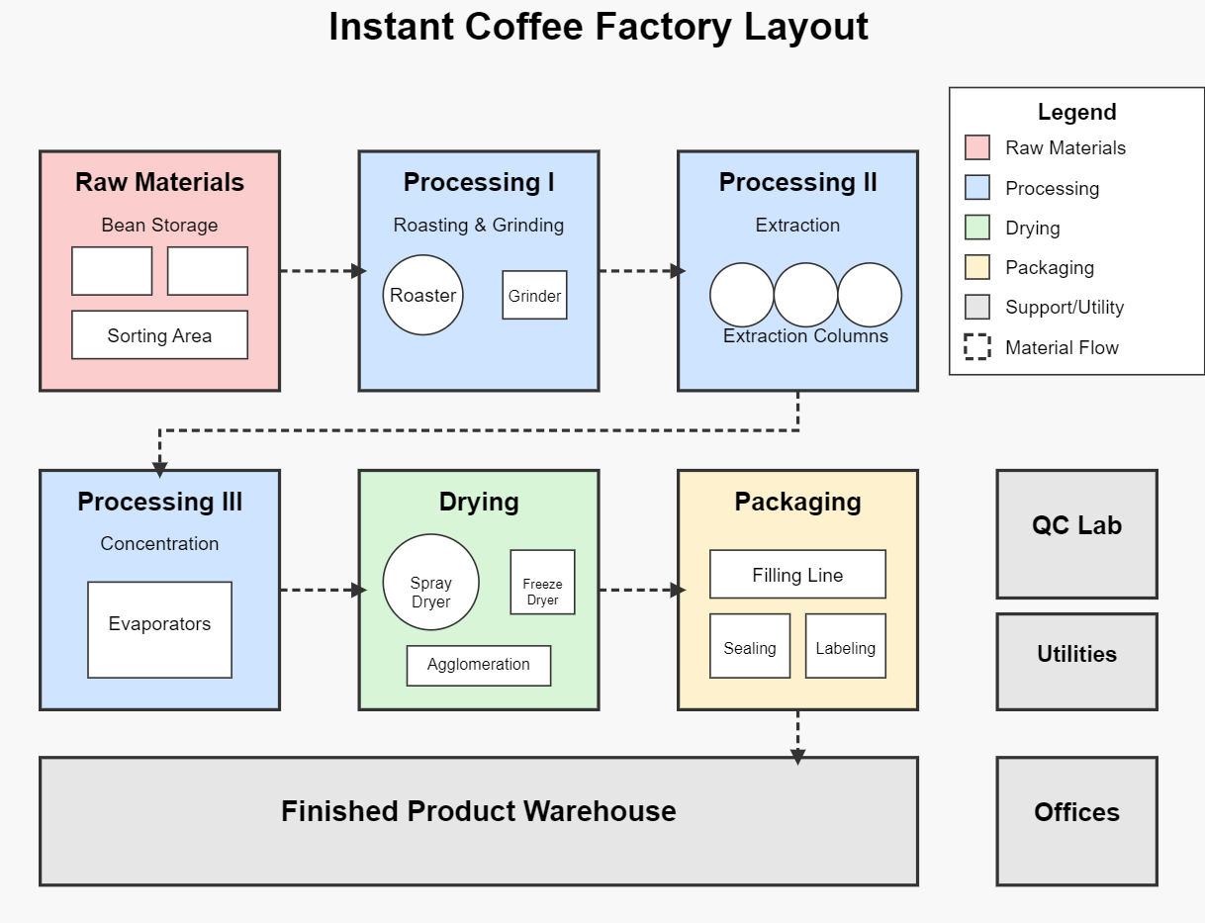

Slide 8
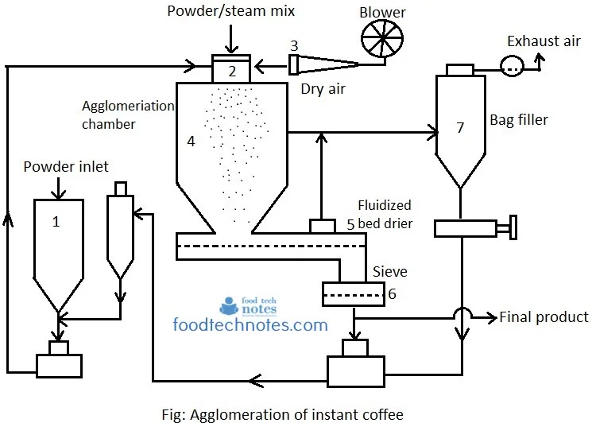
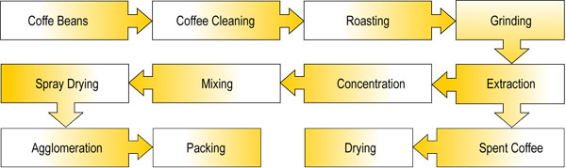
Instant Coffee Factory
Bean
Silo
Bean
Silo
Roaster
Grinder
Extraction Columns
Concentrator
Spray Dryer
Freeze Dryer
L
L
Packaging
L
Product Warehouse

Slide 9
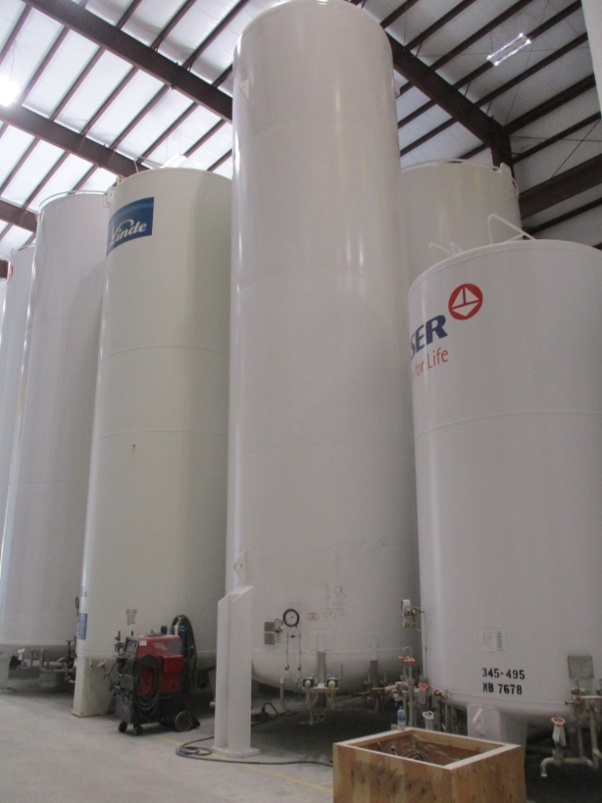
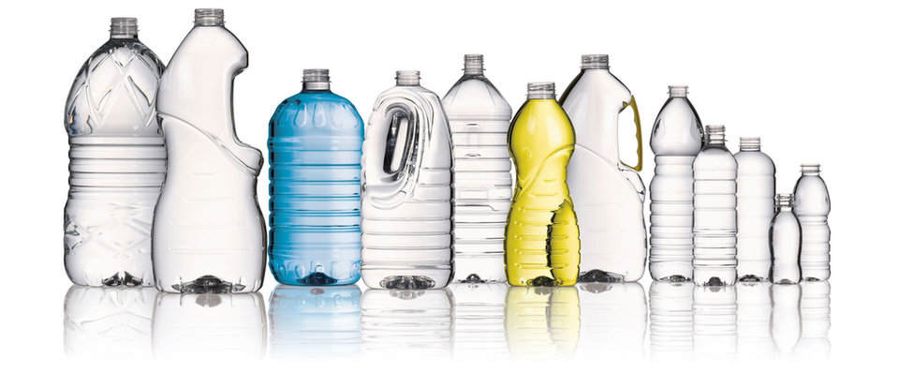
Drink Factory
Dry
Silos
Liquid
Silos
Refrigerated
Silos
Water Tank
Filtration
Pools
Filtration
Mixer
Filtration
Pools
Silos
Carbon Dioxide Tank
Carbonation
Pasteurization
Container
Sanitization
Packaging
Labeling
Warehouse

Slide 10
Notes – External Data Sources
Public:
https://thingspeak.mathworks.com/channels/1293177
https://thingspeak.mathworks.com/channels/2057381
https://www.gridstatus.io/live
https://data.cityofchicago.org/Parks-Recreation/Beach-Weather-Stations-Automated-Sensors-2016-Humi/7edu-s3u7
https://opendata.cityofnewyork.us/
AWS Data Market:
https://aws.amazon.com/marketplace/search/results?FULFILLMENT_OPTION_TYPE=DATA_EXCHANGE&DATA_AVAILABLE_THROUGH=REDSHIFT_DATA_SHARES&filters=FULFILLMENT_OPTION_TYPE%2CDATA_AVAILABLE_THROUGH

Slide 11
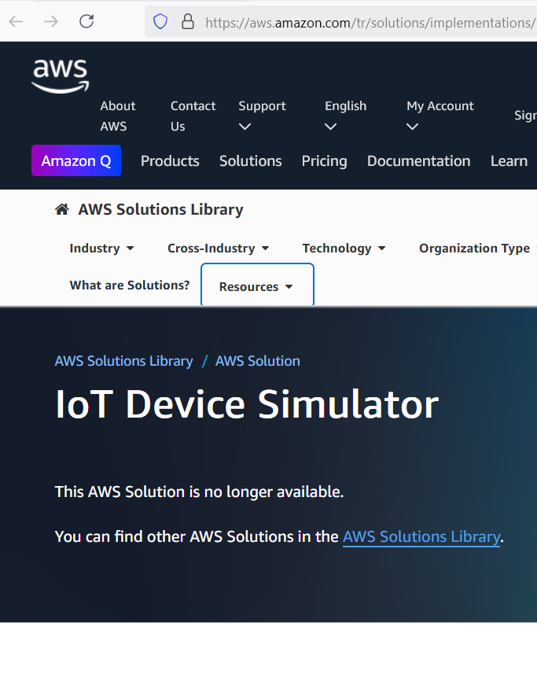
https://www.linkedin.com/pulse/simulating-iot-virtual-devices-node-red-backing-up-node-ajay-mahajan-vk0cf

